Slide 1
Health As Infrastructure
USA Healthcare Alliance

Slide 2
Why Should We Care about the Classification of Healthcare?
Healthcare as Infrastructure Already the Standard Internationally: Most foreign health officials already view healthcare as infrastructure
Exclusion from Infrastructure Agenda Starves Healthcare of Resources: Excluding healthcare from infrastructure limits the flow of public and private sector funding into healthcare
Better Alignment with Economic Policy: Recognizing healthcare as infrastructure increases the likelihood of aligning macroeconomic and sectoral policies
Increased Support/Funding by MDBs: The mandate of Multilateral Development Banks (MDBs) focuses on support for infrastructure as “sustainable” investments. This can and should include healthcare including hospitals
Healthcare as Growth Driver: Healthcare infrastructure directly contributes to, or detracts from economic and recovery- before, during and after C19

Slide 3
What is Healthcare Infrastructure?
Physical facilities including hospitals, clinics, equipment, and support facilities for R&D
Education & training systems- so-called “soft infra” determines success and failure very often
Healthcare IT systems: Healthcare IT systems can include maintenance, management, and sharing of electronic health records, referral management, and tele-medicine
Healthcare advice and consulting
Healthcare Insurance and Reimbursement: Frameworks and actors are critical.
Regulatory framework that ensures effective insurance products, and credible healthcare services meeting minimal quality criteria:
  Entails a public or private regulatory approval or licensing framework
  Requires effective enforcement authority and capability
Integrated Care Pathways: To ensure hospital sustainability and improve outcomes, patient pathways through primary, secondary, and tertiary healthcare systems need to be integrated

Slide 4
Why Should USG Promote Healthcare Infrastructure Abroad?
Increase U.S. Healthcare Exports: U.S. healthcare industry is a world leader --support will increase exports in multiple sectors
Expand Exports of Complementary Services/Goods: Growth in healthcare exports means growth in exports of complementary services/goods
Strengthen Bilateral Ties: Helps build/strengthen bilateral relationships by helping countries address public policy goals
Boost Global Health Security: Strengthening healthcare systems supports global health security goals
Critical to be Politically Neutral: Healthcare should and often does stand above political fray. To be credible, those efforts should be share between all US political parties.

Slide 5
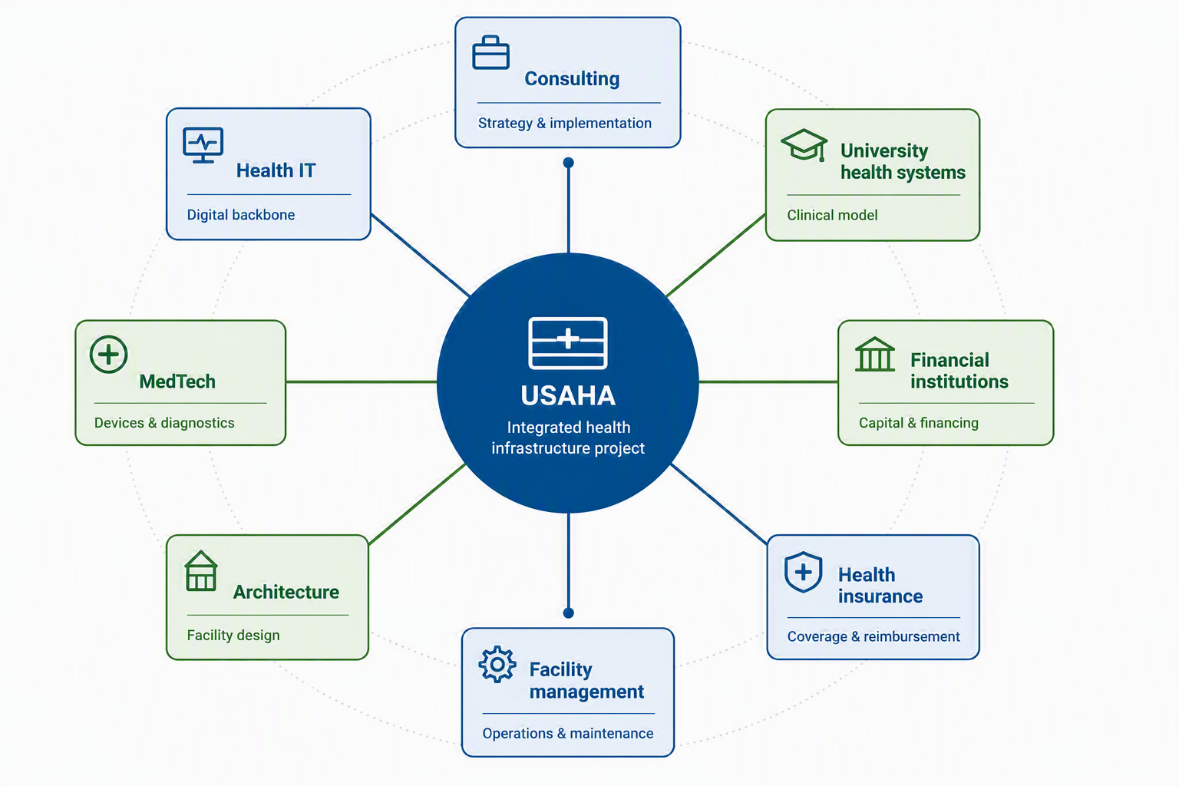
Multiple Industries within Healthcare Infrastructure

Slide 6
How Can USG Support Healthcare as Infrastructure?
Persuade MDBs: Use USG shareholder interest to persuade MDBs to include healthcare in infrastructure proposals, and include hospital systems as key infrastructure investments
USG Coordination and Consistency: Greater coordination across USG (e.g., interagency international infrastructure working group) on healthcare as infrastructure
Diplomatic Engagement: Diplomatic engagement with foreign governments about the importance of healthcare to economic growth
Advocacy: Department of Commerce advocacy on tenders/contracts/procurements

Slide 7
Why Now?
U.S. Needs to Catch Up: The European Bank for Reconstruction and Development has already begun treating healthcare as infrastructure. U.S. rivals (e.g., China’s AIIB and China’s BoR initiative) have now formally started doing healthcare infrastructure during Covid-19. The US has been slowed by traditional definition of infra (dams, power, road, etc)
MDBs Recognize Need for Quality Healthcare: MDB officials have begun to realize that healthcare is an important part of a country’s infrastructure even if their policies have not yet completely changed
Foreign Officials Receptive: More and more countries are learning that investment in healthcare, like investment in education, pay dividends in the future
Country Decision-Making: Countries need to deal with tactical needs during C19, but want to ensure these investments are durable, break down traditional disease barriers.
Build Back Better World. Political momentum supports the shift- and now.

Slide 8
Contacts
Trevor Gunn
Founder, Chair, President | USAHA
Trevor@US-aha.org
Avani Gangavelli
Executive Director | USAHA
Avani.Gangavelli@US-aha.org
www.US-aha.org
LinkedIn

